Slide 1
SharePoint Framework M13
Jenkins NS
@jenkinsns

Slide 2

Agenda
Module 13: Microsoft Teams tabs using SharePoint Framework
Create a Microsoft Teams tab project
Packaging and deploying your web part to SharePoint
Making the web part available in Microsoft Teams

Slide 3
Introduction
SPFx + MS Teams

Slide 4
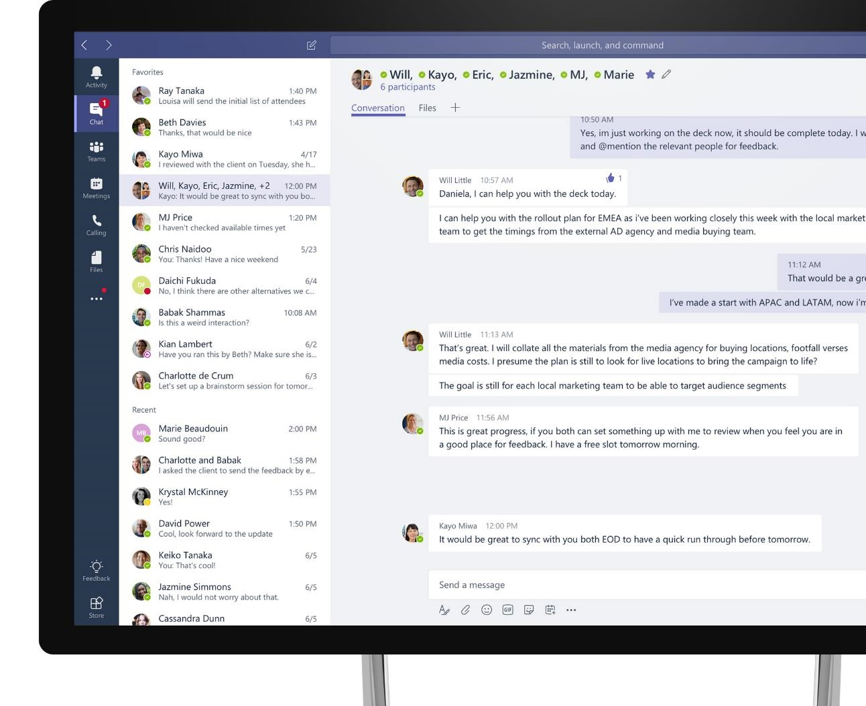
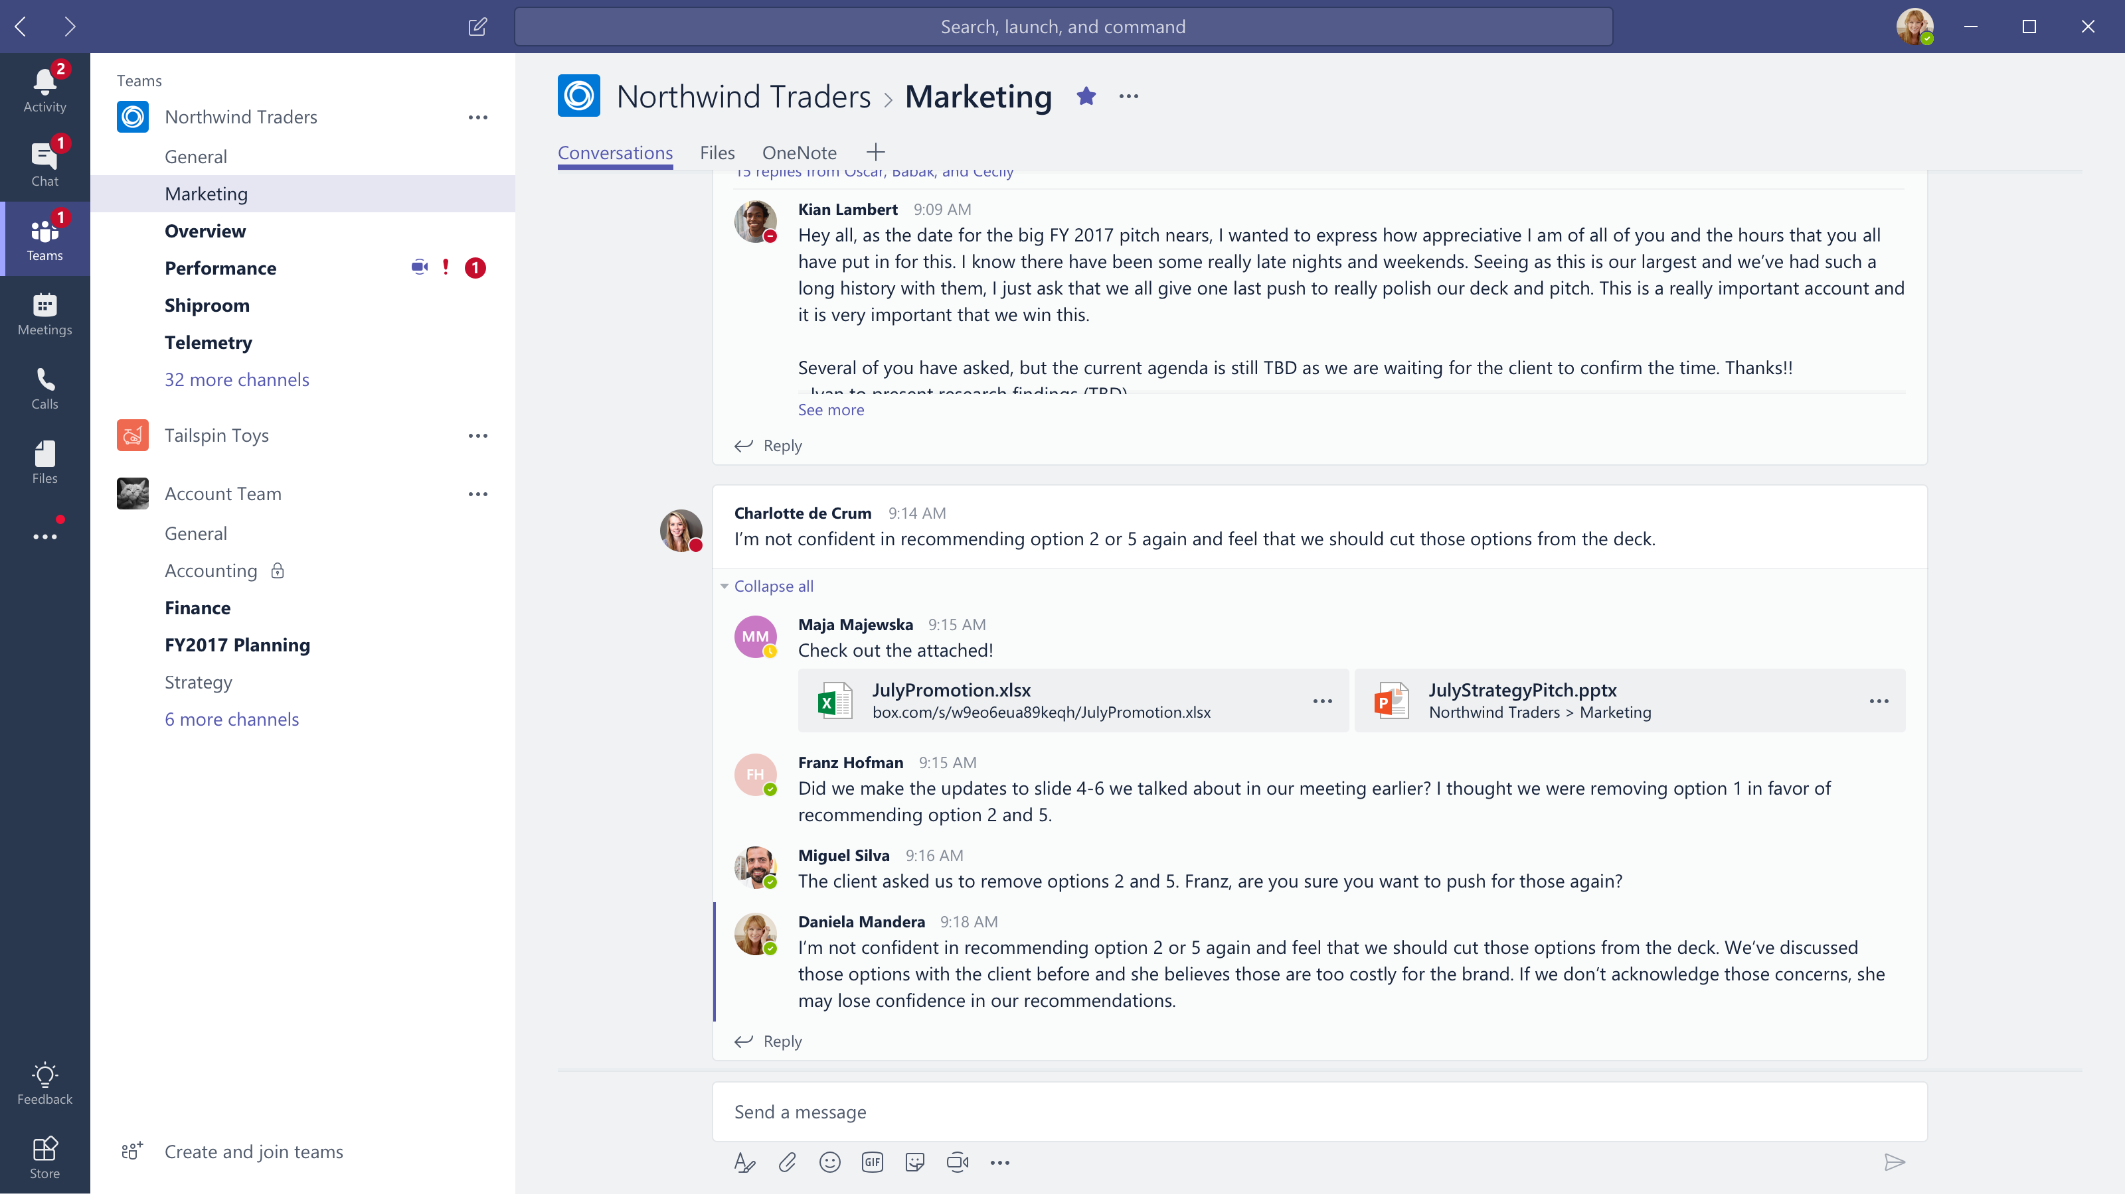










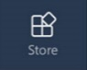
Microsoft Teams
The hub for teamwork in Office 365
Communicate
through chat, meetings & calls
Collaborate
with deeply integrated Office 365 apps
Customize & extend
with 3rd party apps, processes, and devices
Work with confidence
enterprise level security, compliance, and manageability
Notes:
[This is an animated slide. Please show it in presentation mode]
[MAIN POINT TO LAND]
Microsoft Teams is a hub for teamwork, a chat-based workspace that enables teams to be more productive by giving them a single and secure location that brings together everything a team needs: chats, meetings, calls, files, and tools. Microsoft Teams is one place for all the needs your teams have.
Microsoft Teams delivers on four core promises to create a digital workspace for high performing teams.
[COMMUNICATE]
First, Microsoft Teams solves for the communication needs of a diverse workforce.
Since preview, Microsoft Teams has evolved to include a complete meetings experience, as well as chat, voice and video -
You can use Teams for informal 1:1 or group chats – directly on your phone if you’re on the go. Or you can have an open conversation in a channel. This enables people to share information in a transparent way to accelerate decision making. And it's super easy to move from a chat into a face to face meeting, helping you to bridge geographical barriers.
[COLLABORATE]
When it comes to collaboration, the deep Office integration enables today’s multigenerational workforce to use the Office apps they are familiar with and love - Word, Excel, PowerPoint, OneNote, SharePoint, Planner, even Power BI - right within the context of Teams. Teams is unique in how we enable collaboration.
Today, when you want somebody’s feedback, you send them the file via email, they store it locally with comments, you store it again…… it's a vicious cycle that results in v2, v3, v4 versions – and you have to jump between email and other apps to get the work done. Teams brings all the Office 365 services together – so that you can easily share and co-author files without the need for email attachments.
[CUSTOMIZE]
Many of you use other services than Office 365 as well which results in you having to jump between and spend time in disparate experiences. We built Teams to not only be the hub for Office 365 services, but for all the services and tools teams use on a day to day basis. So, you can customize Teams with tabs, connector and bots to include the apps and services you need - <mention relevant 3rd party apps like GitHub and Trello that can be included in Teams>– we have integrations with over 150 partners. For our developer community, we have also created an extensible platform, to enable building apps and to integrate with business processes.
[WORK WITH CONFIDENCE]
Microsoft Teams comes with the enterprise grade security, compliance and manageability that you expect from Office 365 which customers tell us is a huge value add for them.

Slide 5


Current State of SharePoint and Teams
SharePoint Extensibility
Build modern SP solutions
Full-trust JavaScript based framework running in the main app
Use modern auth to integrate with Graph
SP add-ins
Provider-hosted based via iframes
Low-trust, end user acquisition model
Distribute via Office Store
Teams Platform
Build apps to custom tailor your teams
Modern embedding via tabs
Enhance integrations via bots, messaging extensions, Adaptive cards, and Graph
Add communication services, e.g. programmable voice and video

Slide 6
Our Expectations
Information the team cares about should be available regardless of the tool / workload
Make it possible to bridge team collaboration and external communication
End user
Enable users to collaborate around the same content in SharePoint and Teams
Centralized Admin experience and tools, including LOB app distribution
Common developer framework for building solutions targeting both SharePoint and Teams experiences
Reduce the number of places and ways to manage and deploy solutions to end users
IT admin
Reach multiple workloads with a single solution
Reduce number of developer concepts and experiences
Developer

Slide 7


Single platform for hosted experiences
O365-hosted apps
(“SPFx solutions”)
Provider-hosted apps
Rich canvases
Future
Common platform and runtime
Microsoft Graph
Build your solution to run across Teams, SharePoint, and (eventually) all of Office

Slide 8
Surfacing SPFx in Teams
Deploy your existing SharePoint web part into Teams as a tab
This features available from 1.7 plus beta version.
yo @microsoft/sharepoint

Slide 9
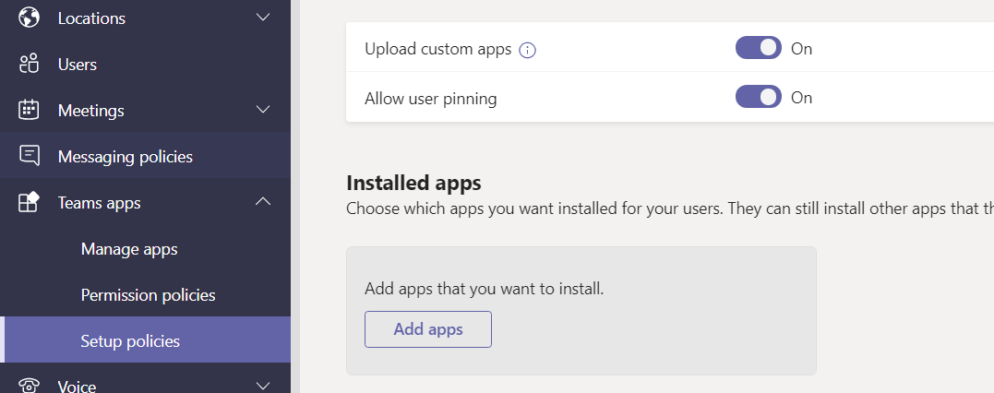
Instructions for enabling side loading
As part of the Developer of SharePoint Framework Teams Tabs, you will need to explicitly deploy the Microsoft Teams app to a Team in Microsoft Team. Your tenant will also need to support Side loading of custom apps for the Microsoft Teams, so that you can deploy the app to a specific Team and use it
Go to https://admin.teams.microsoft.com/
Teams apps
Setup policy
Add or edit exiting global (org-wide default)

Slide 10
Bring SPFx Solutions into Teams Tab

Slide 11
SPFx Targeting Teams Tabs
SPFX as the standard way for Enterprise Devs and SIs to Develop “O365-hosted” solutions across SharePoint and Teams
Developers will be able to “target” the environments in the manifest.json
Single point of governance in the App Catalog
Standard “features” of SPFx
Toolchain
Authentication
SP, Graph and WebAPI Access
CDN hosting
Config experience
Solution hosting
Component is able to get the right application context

Slide 12

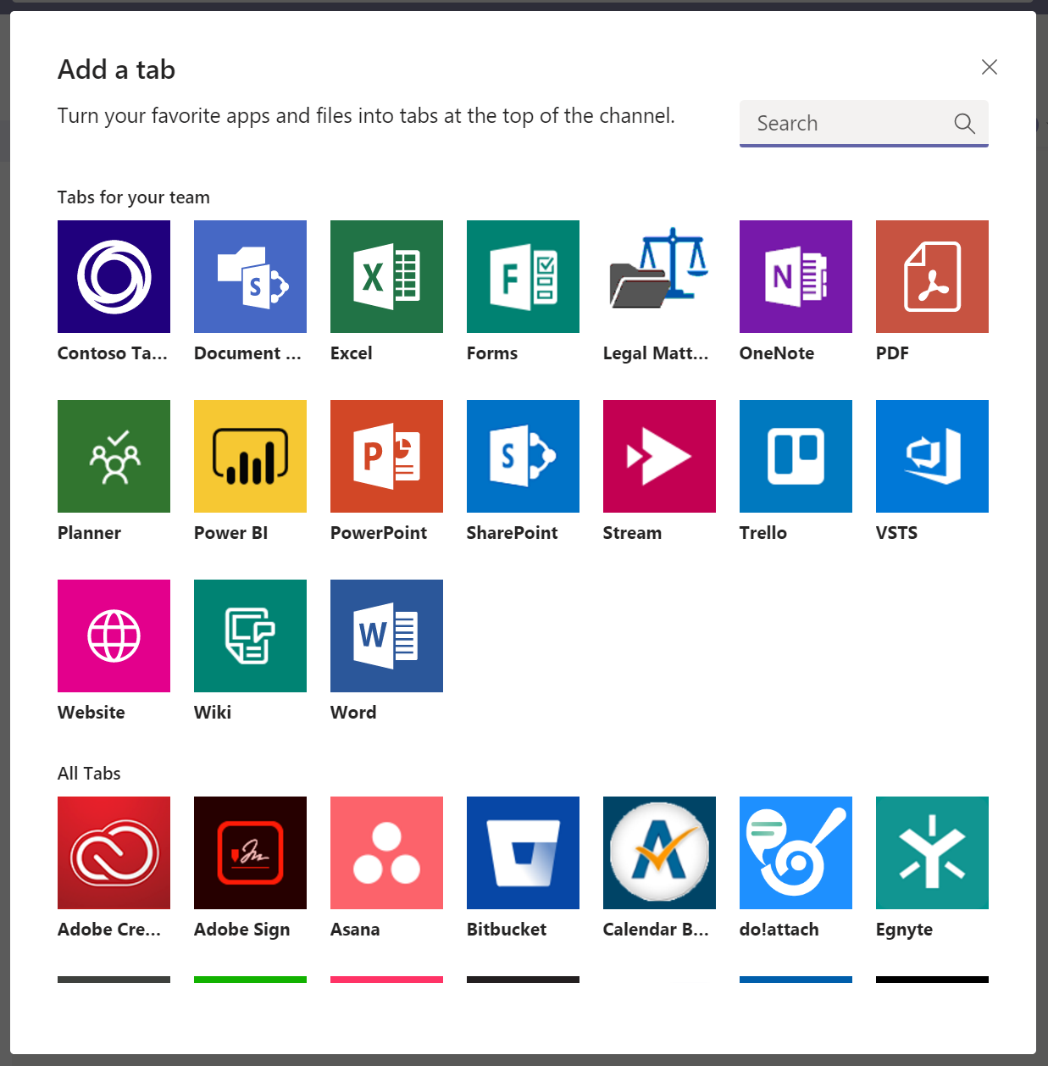
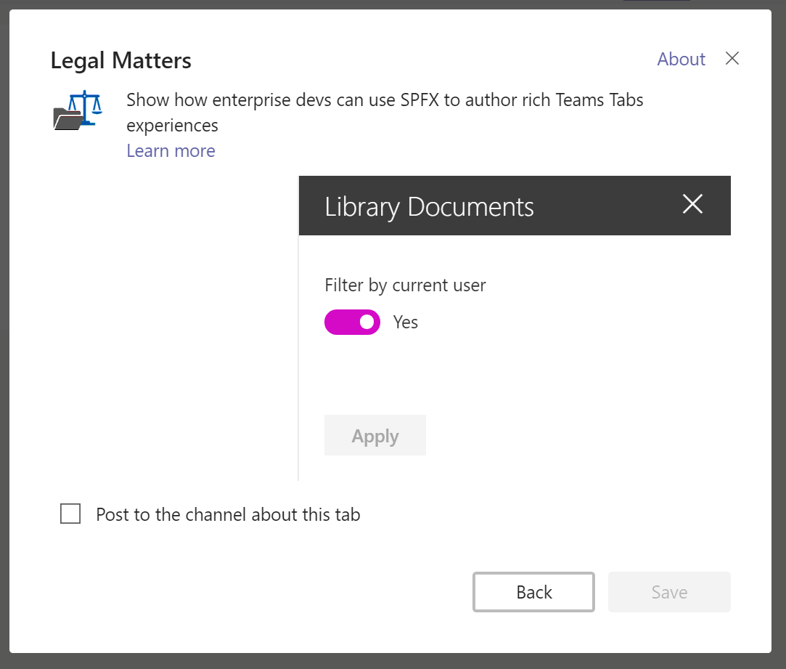
Bring SPFx Solutions into Teams Tab
SPFx Teams solutions are deployed to Office 365 tenants using tenant app catalog
Microsoft Teams
SharePoint Online
1
Teams manifest file is created and deployed in Teams LoB Catalog
2
zip
Tenant App catalog
User selects the SPFx application like any other tab in MS Teams “Add a tab” experience
js
SPFx solution
3
Configuration panel is displayed and, once saved, information are stored in the SPO site connected to the group
4
Configuration List

Slide 13
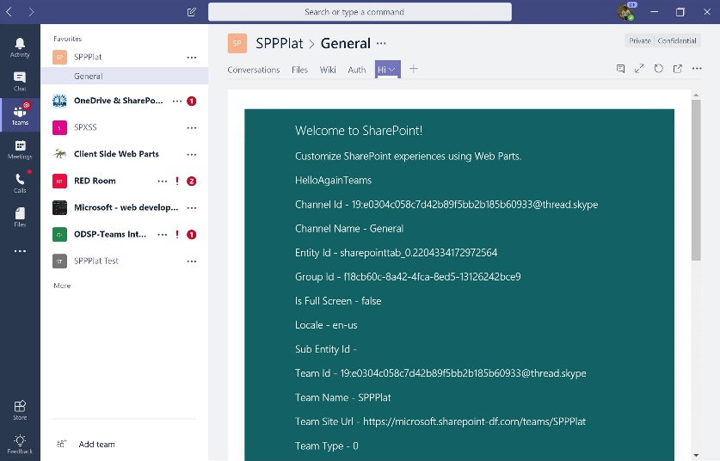
Bring SPFx Solutions into Teams Tab
SPFx component renders in a dedicated _layout page which is iframed in Teams
Microsoft Teams
SharePoint Online
5
Teams and SharePoint site context are available to developer
6
SPFx Application
Code is loaded from SharePoint asset library where it was deployed at time of package upload
Webpart.aspx
7
Alternatively, code can also run in different CDN location
js
7
js
Asset Library
js
js

Slide 14
Authentication
Silent authentication between Teams rich client and SPO
Teams provides the token client side to SharePoint
It convert it to cookie server side
The _layout system page that hosts the SPFx solution renders: no additional auth required
Full access to SharePoint REST APIs
When / if the component requires to access Graph / Web APIs:
We get the auth token from the client: no permissions there, we use it as bootstrap token
SPFx client libraries understand that the call is coming from a Teams rich client environment*
Bootstrap token is sent to AAD using the “on behalf of” flow to obtain an access token for the requested resource in exchange for the bootstrap token
AAD returns the access token to SPO. The component can now execute the Web API call.

Slide 15
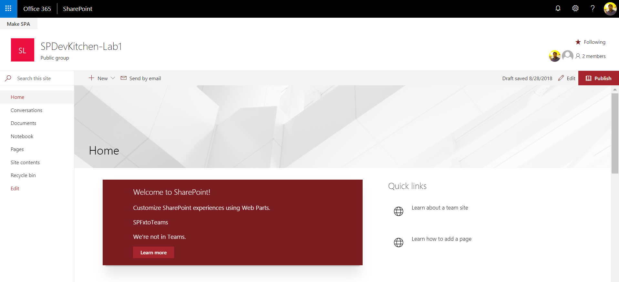

Slide 16
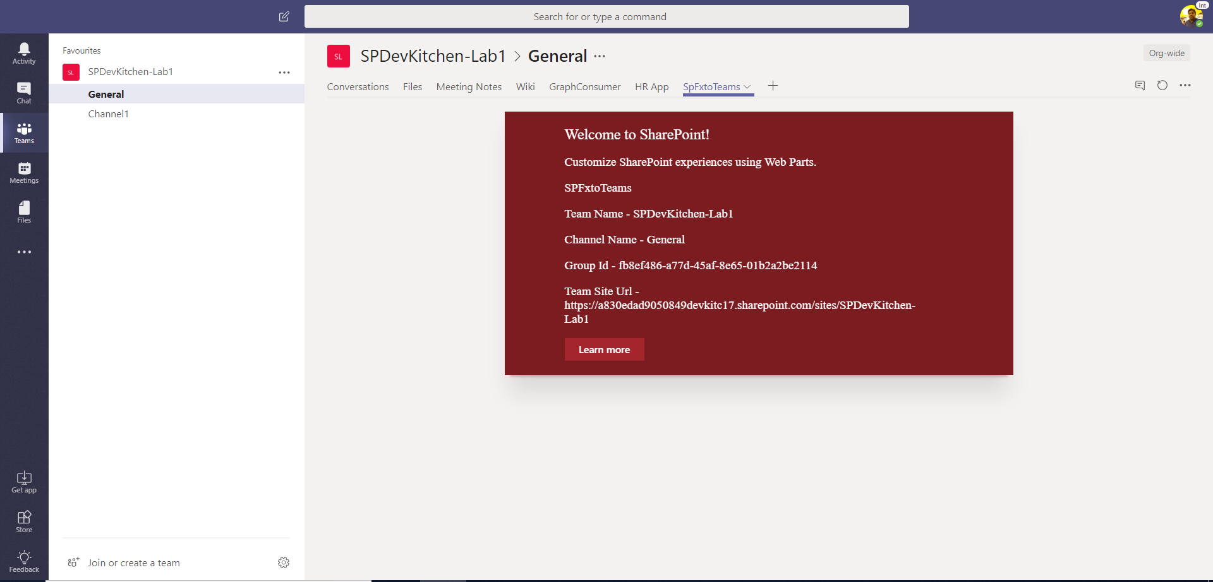

Slide 17
Demo

Slide 18
Demo
SPFx + MS Teams Webpart

Slide 19
References
https://pnp.github.io/pnpjs/sp/

